Slide 1
Angular

Slide 2
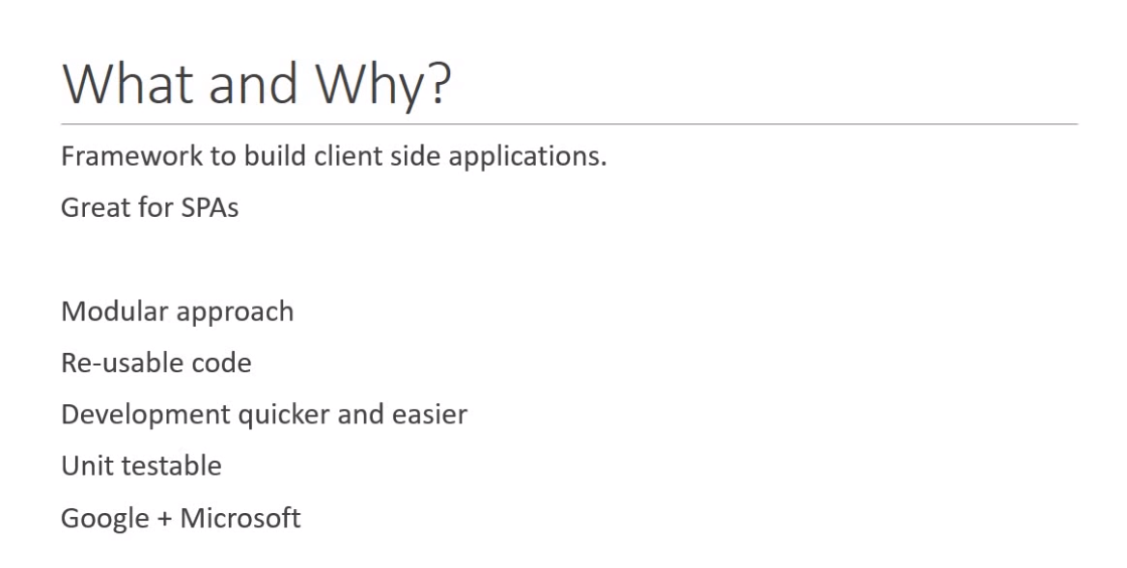

Slide 3



Why Angular?

Slide 4
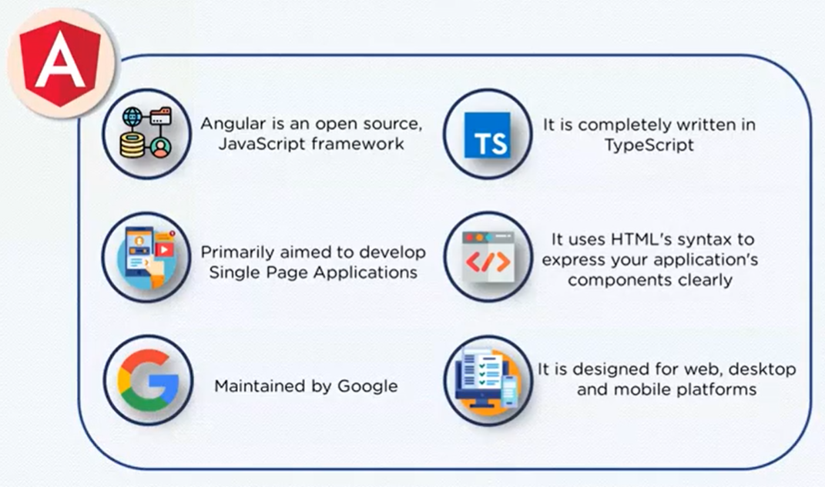
What is Angular?

Slide 5
Angular History
2010 – Angular JS (1.X version)
2016 – Angular 2
2016 (Dec) – Angular 4 ( Routing)
2017 (Nov)- Angular 5 (web Apps)
2018 (May)- Angular 6
2018(Oct) - Angular 7

Slide 6
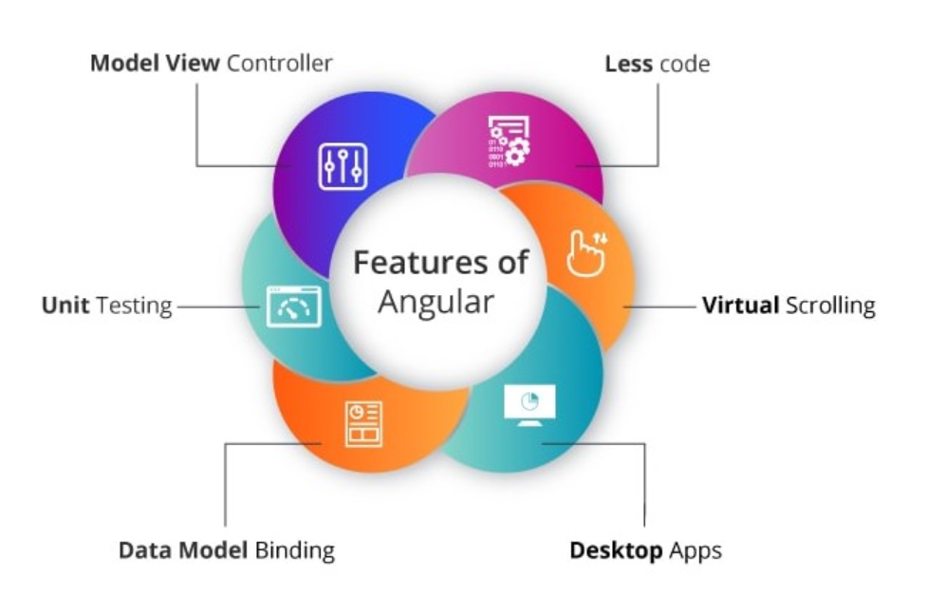
Features of Angular

Slide 7

Angular Architecture

Slide 8
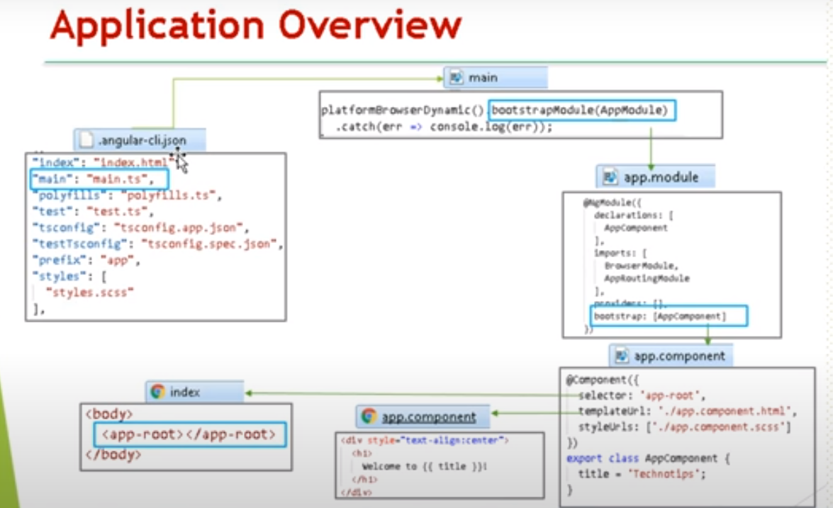
How does angular work?

Slide 9
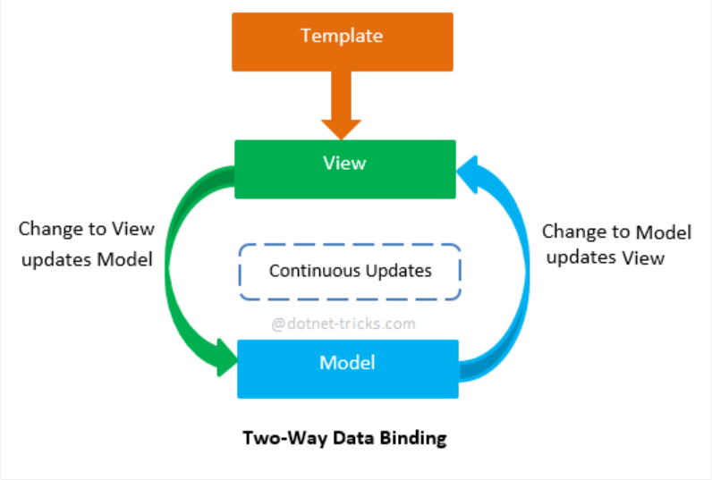
Two Way Binding

Slide 10
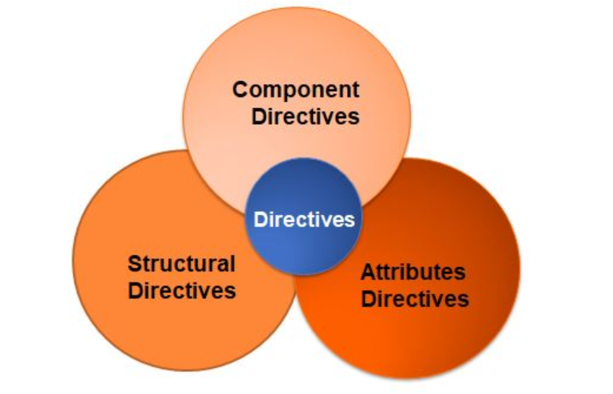
Directives in Angular
Component Directive -

Slide 11
Directives
Component Directive is a class with @Component decorator function.
As we know that angular app contains at least one component called AppComponent
which is present inside the App-compoennt.ts file.
Structural directive modifies or manipulates the structure of DOM by adding or removing DOM elements.We can say that basically, it works on the structure of a DOM.
example, *ngIf and *ngFor etc..
Attribute directives deal with the changing of look and behavior of
the dom element, component or another directive. It is also used as attributes of elements.
Example:ngStyle , ngClass

Slide 12
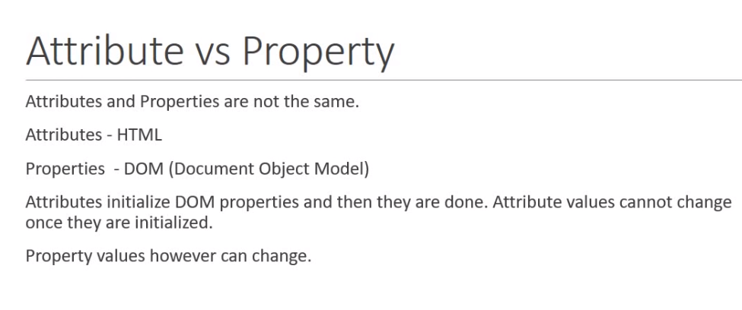

Slide 13
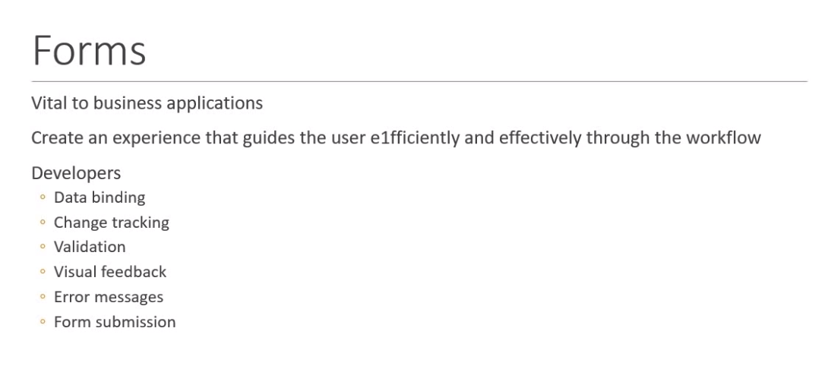

Slide 14
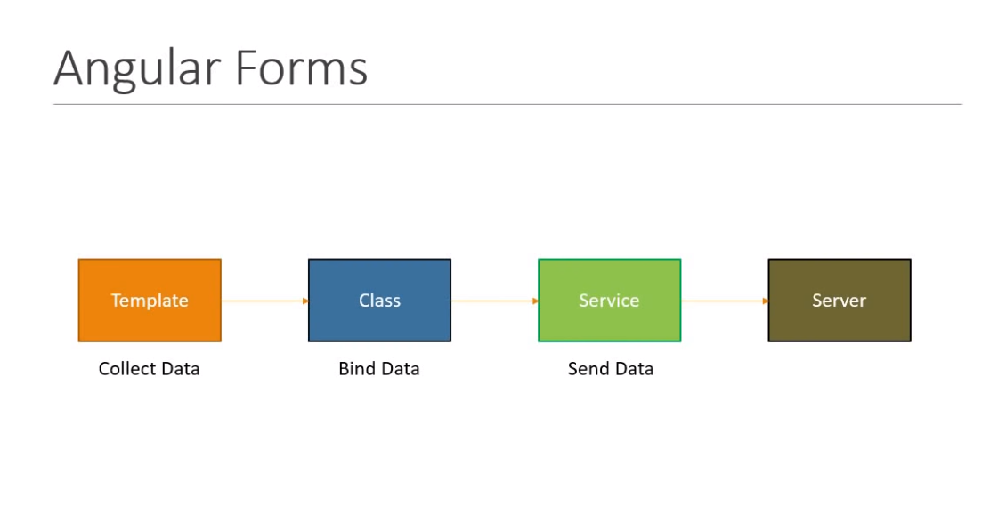

Slide 15
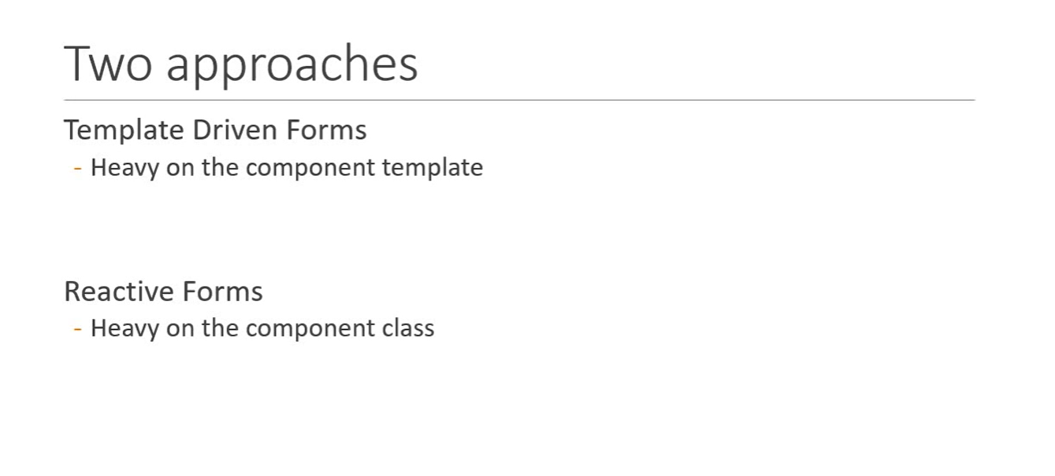
Types of Forms

Slide 16
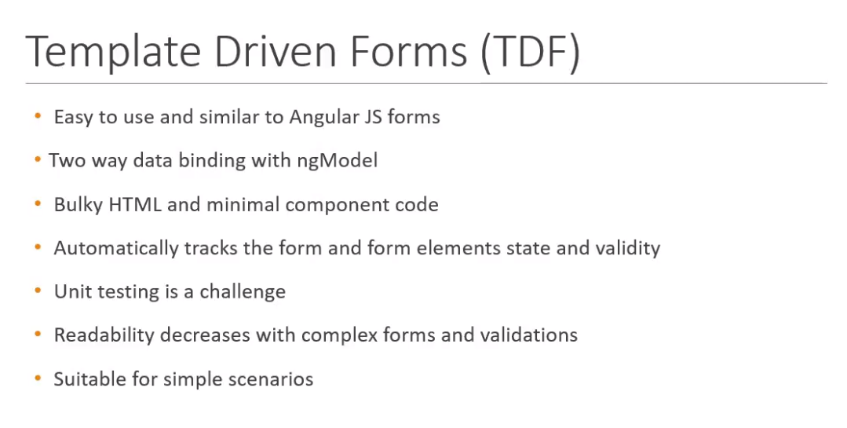

Slide 17


Slide 18


Slide 19
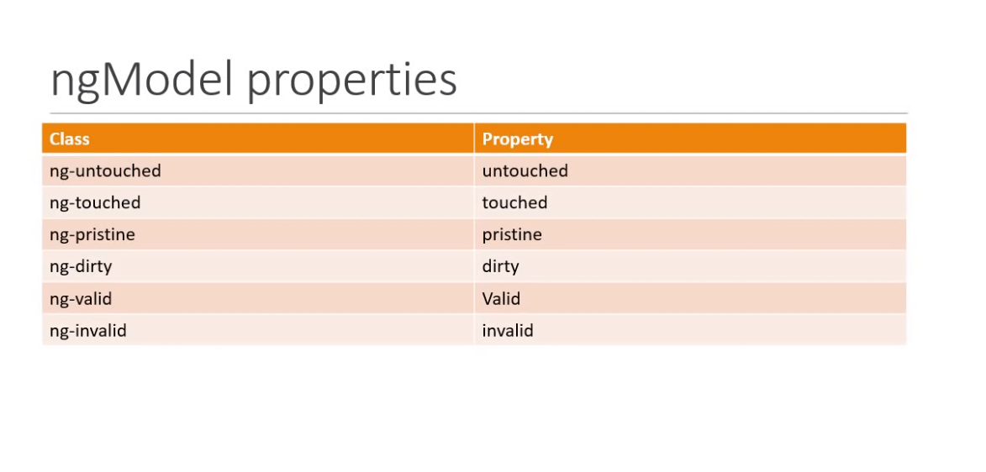

Slide 20
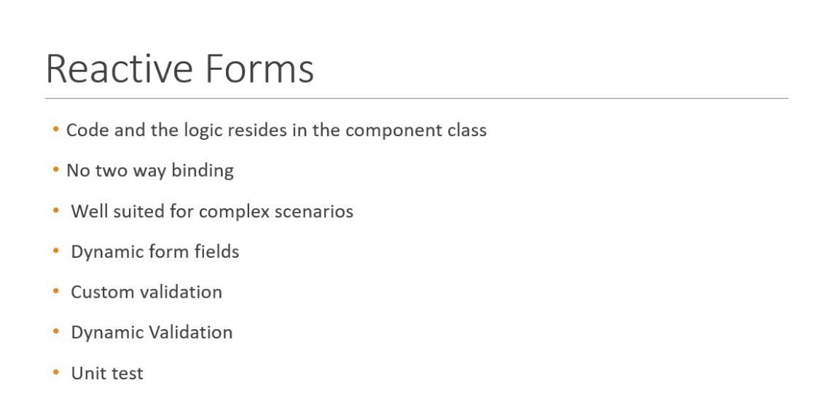

Slide 21
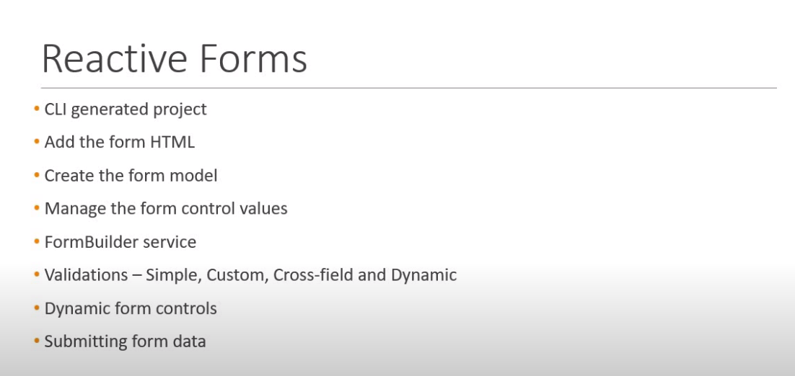

Slide 22
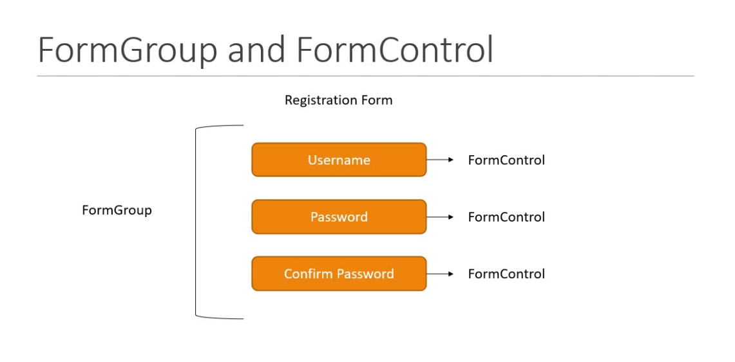

Slide 23
Validation
Validation
Custom validation
Cross field validation
Conditional validation
Note :? Validation Operator

Slide 24
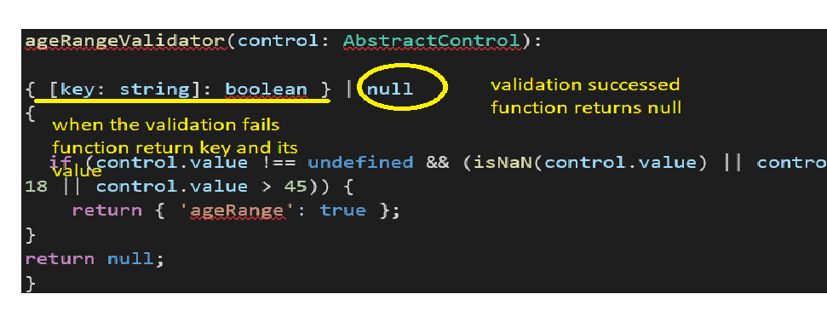
Custom Validation

Slide 25
Routing and Navigation
Way to handle invalid Routes
--wildcard route
Setting a default route
const routes: Routes = [
{path:'',redirectTo:'/home',pathMatch:'full'},

Slide 26
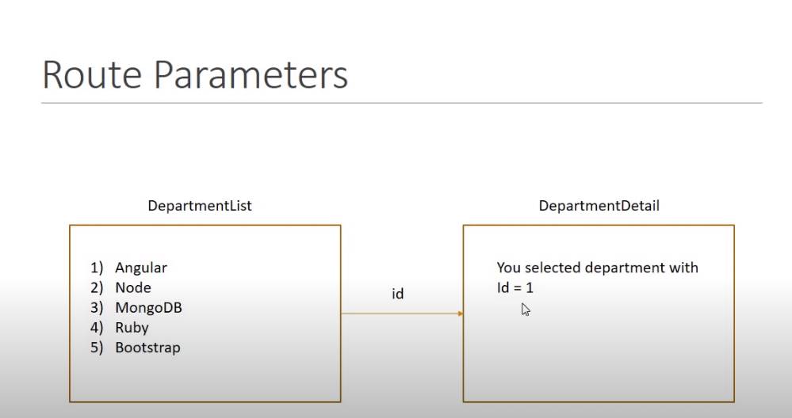

Slide 27
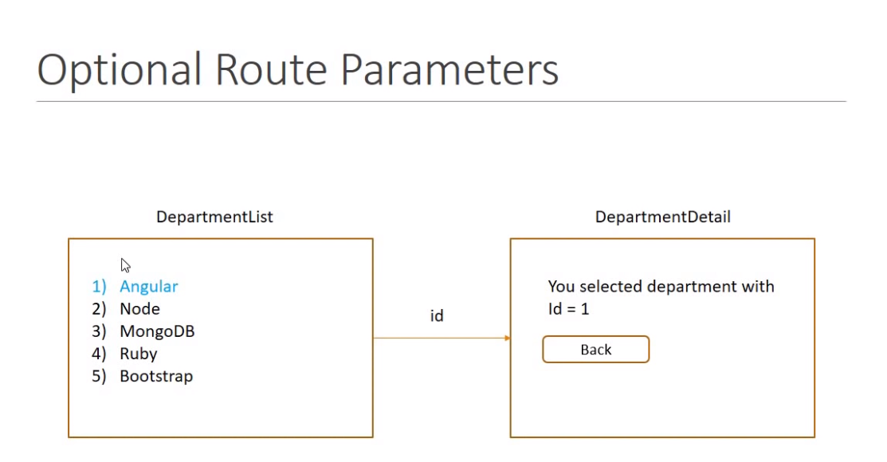

Slide 28
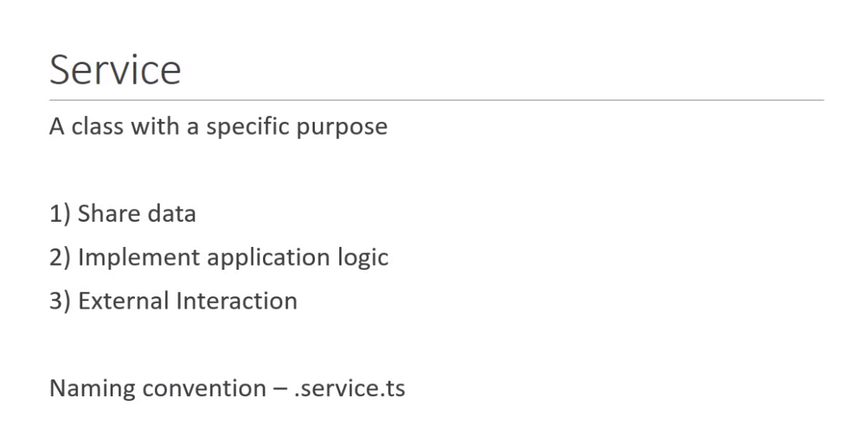

Slide 29
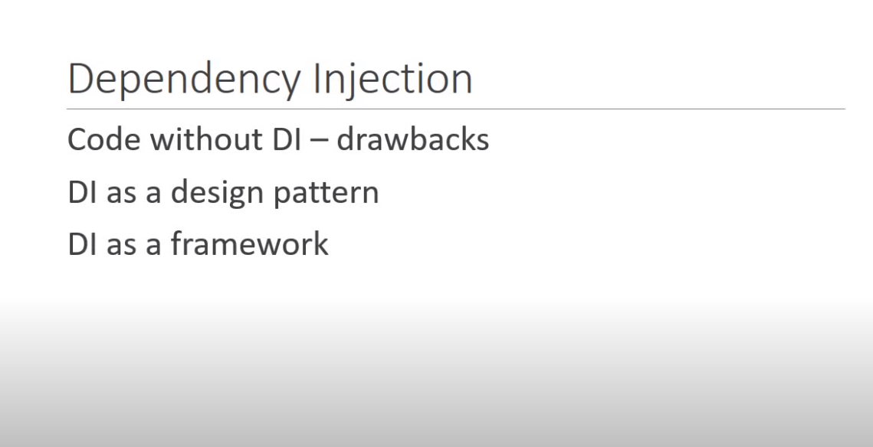

Slide 30
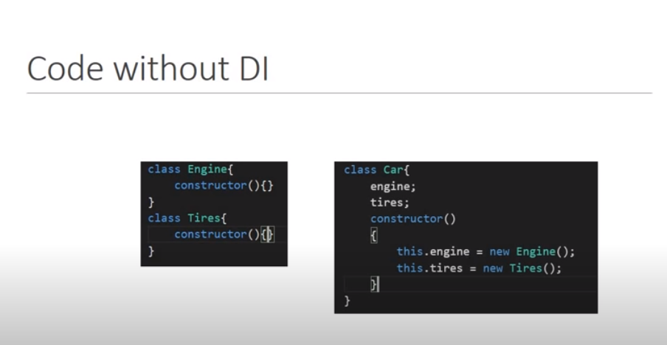

Slide 31
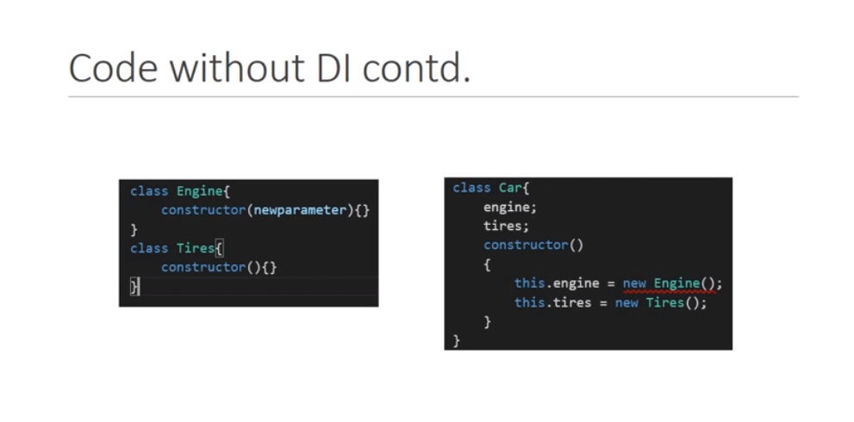

Slide 32
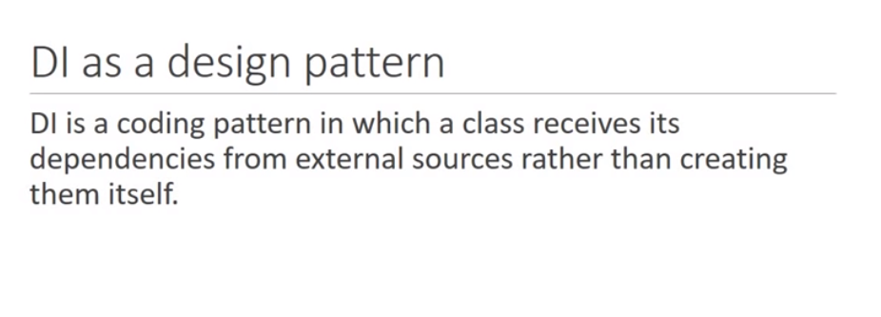

Slide 33
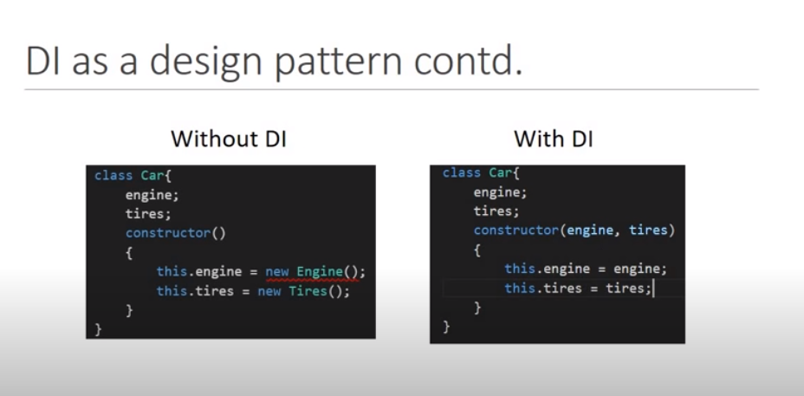

Slide 34
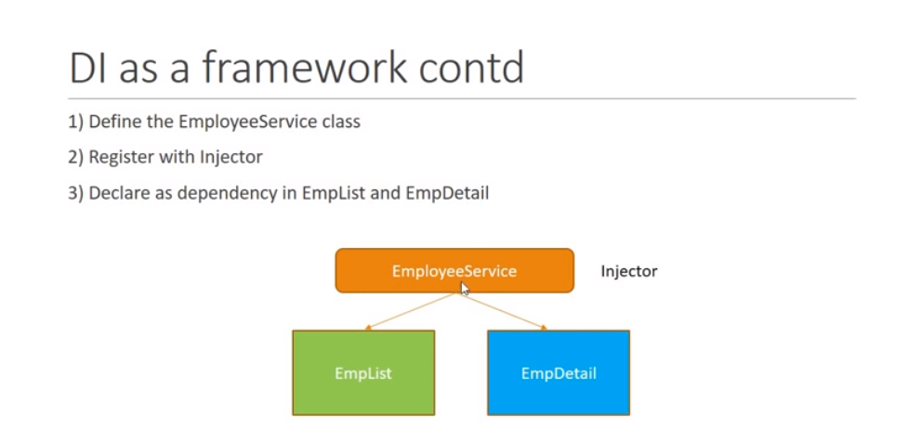

Slide 35
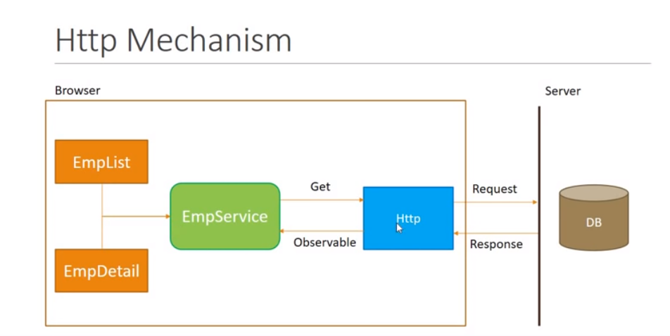

Slide 36
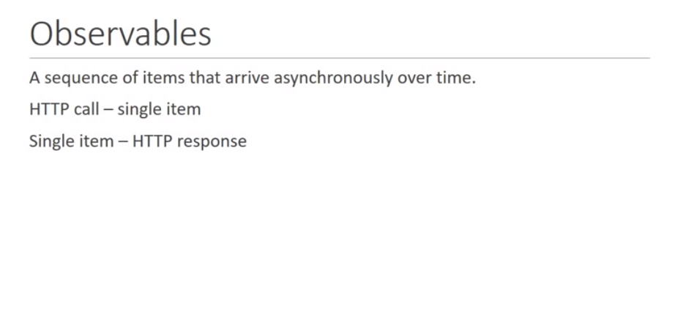

Slide 37
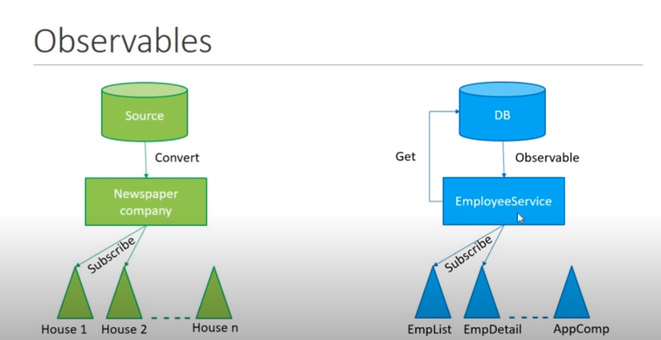

Slide 38
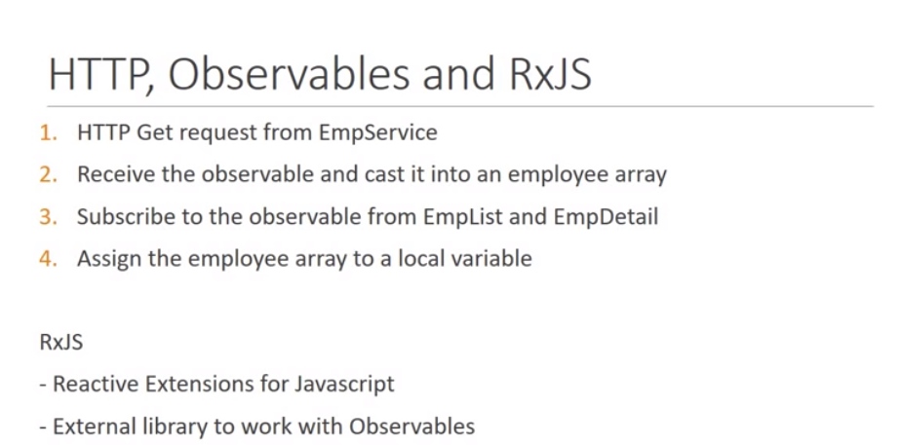

Slide 39
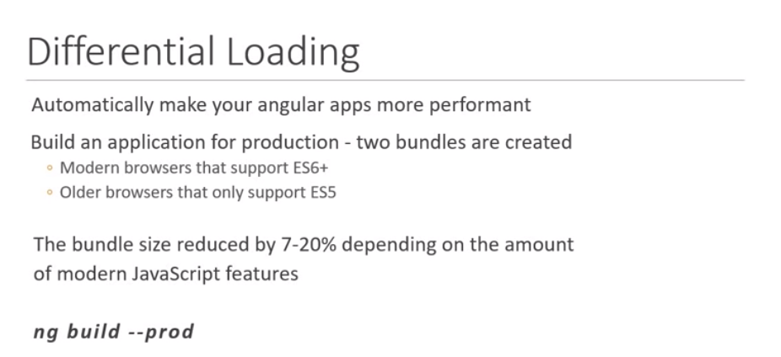
Angular 8 Features

Slide 40
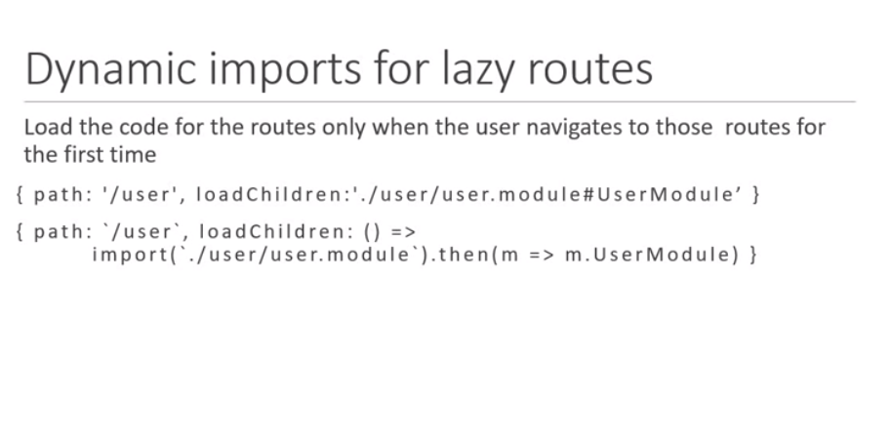

Slide 41
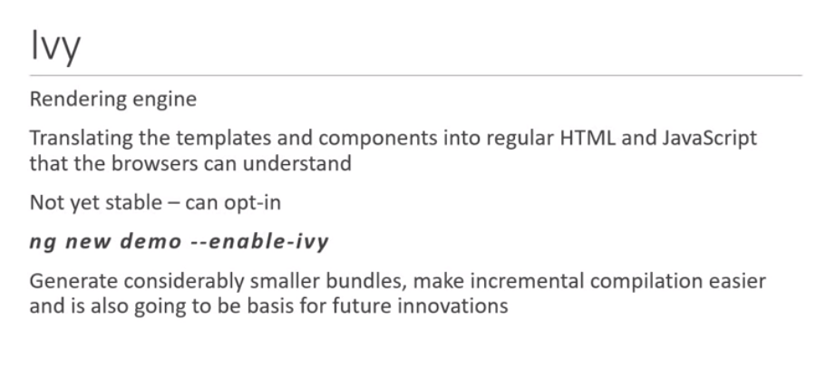

Slide 42


Slide 43
